Slide 1
Eli Chandler Sprint 004
June 7 – June 21
Work hard rating 3/5

Slide 2
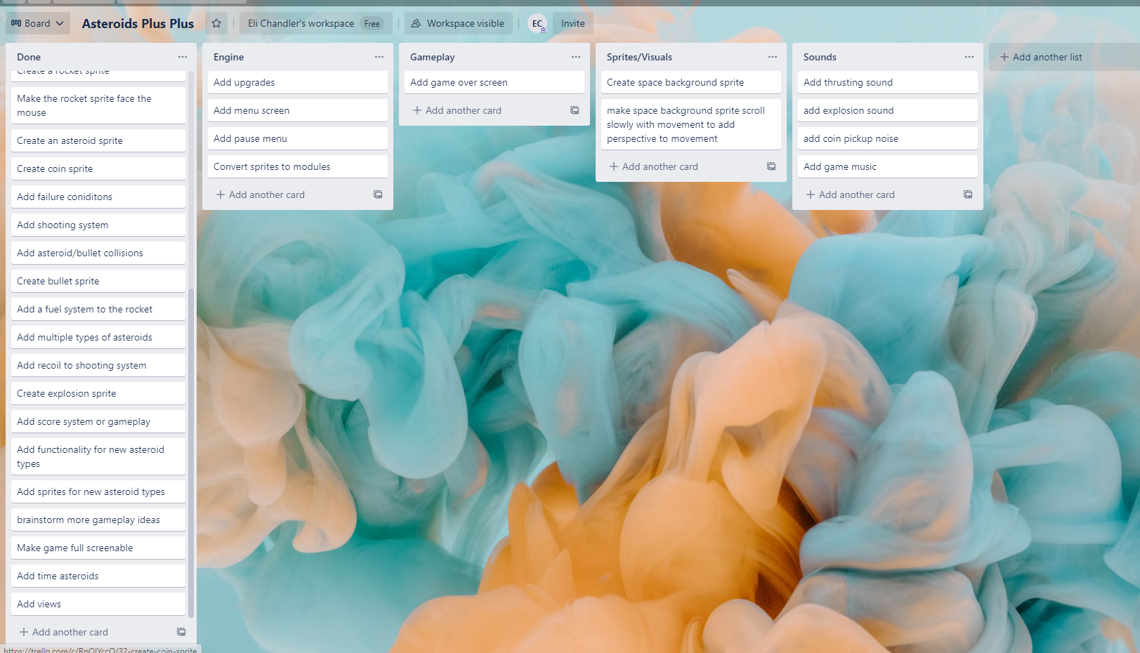
KANBAN Board at the start of the sprint

Slide 3
Sprint reflection and summary
I think that learning the arcade gui module was useful, the basic menu screen has advanced my knowledge and I should now more easily be able to create my upgrades menu in the game now that I understand how all the UI elements work.
Modulizing the game was good because it ensured I was using good coding practices and made the code more readable and organized.

Slide 4
Major changes and achievements
During this sprint I added a new view ‘Menu View’ This view is a menu screen that shows on start-up, it currently only has the option to press ‘Play’ which starts the game and ‘Toggle Fullscreen’ which toggles Fullscreen mode on and off.
The menu screen will also open and close when the escape key is pressed and will pause the game.
I also converted my sprites and buttons to modules, this helps by splitting up the code and making it easier to read, aswell as making sure the code is written properly, for example making sure there isn’t code in objects that should be in the main update function.

Slide 5
Brief description of your testing
Converting my sprites to modules was essentially a drag and drop process, because the classes don’t require anything from outside their own class except some things that are already being passed in in functions.
The only thing I had to test was pressing escape to return to the menu screen, the issue I had with this was that I was deregistering the UI handlers when closing the menu screen, the simplest solution I found was re-initializing the menu view when I wanted to open it.

Slide 6
Link to testing/results table
N/a
if key == arcade.key.ESCAPE:
window.show_view(MenuView())
as opposed to
if key == arcade.key.ESCAPE:
window.show_view(menu_view)

Slide 7
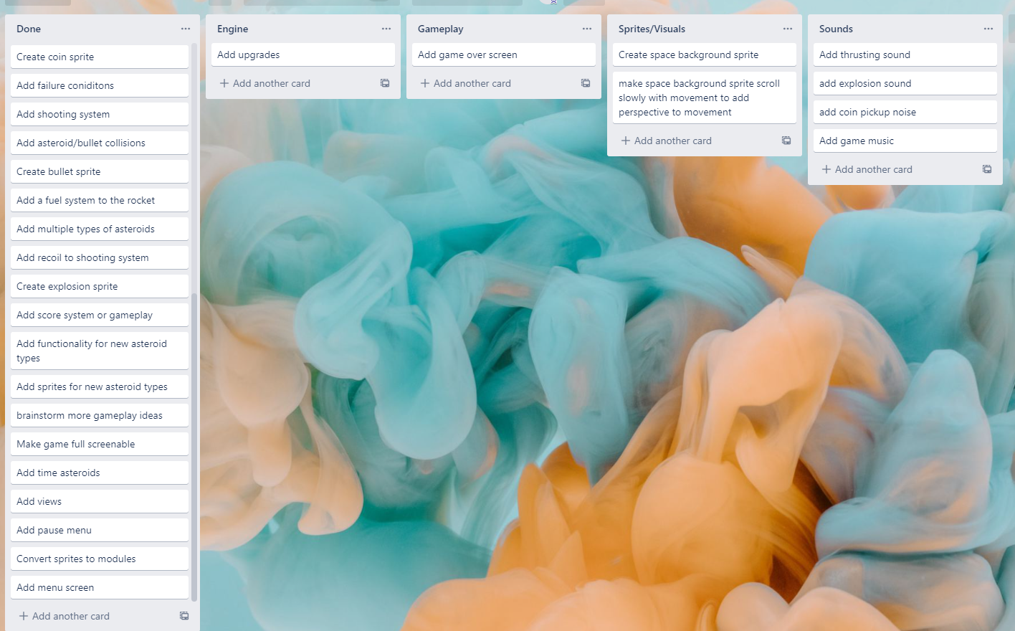
KANBAN Board at end of the sprint

Slide 8
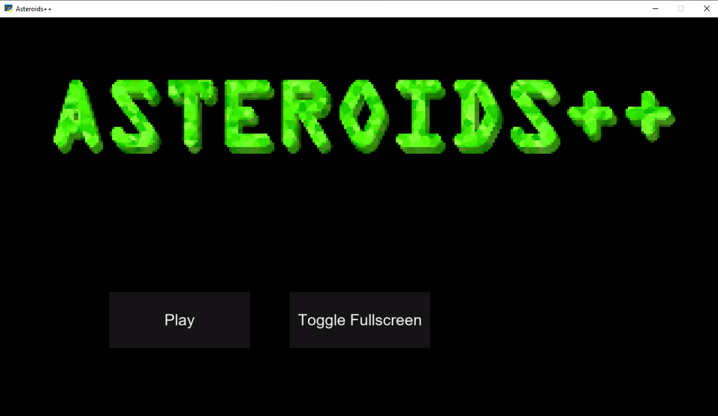
Screenshot of game at the end of the sprint

Slide 9
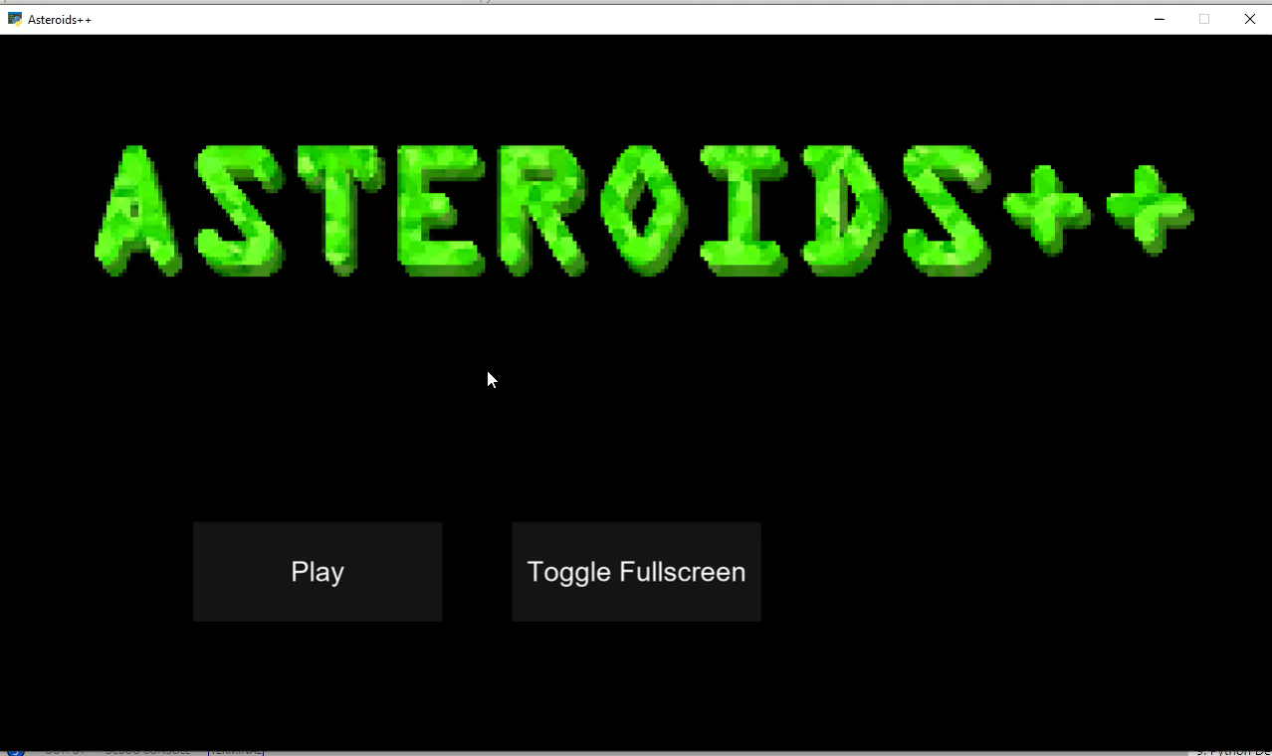
Video of the game at the end of the sprint

Slide 10
Notes for next time, future improvements
One bug I found that I did not fix within the sprint was that the menu will stay at 1280x720 even when the window is fullscreened, I believe I can fix this by calling the setup function again on window resize

